Slide 1
Pre-assessment Questions
    1. Identify the correct return type returned by the doStartTag() method to specify that the body content of the tag should not be processed.
      a. SKIP_BODY
      b. SKIP_PAGE
      c. EVAL_BODY_INCLUDE
      d. EVAL_BODY

Slide 2
Pre-assessment Questions (Contd.)
    2. Identify the correct syntax to specify an empty custom tag which has two attributes, attribute1 and attribute2.
      a. <prefixStr:FirstTag attribute1 = "value1" attribuet2 = "value2" />
      b. <% prefixStr:FirstTag attribute1 = "value1" attribuet2 = "value2" %>
      c. <prefixStr:FirstTag "attribute1 = value1 attribuet2 = value2" />
      d. <prefixStr:FirstTag "attribute1 = value1" "attribuet2 = value2

Slide 3
Pre-assessment Questions (Contd.)
    3. Which design pattern minimizes the network calls that a client makes to a business object?
    a. Model-View-Controller (MVC) Architecture
      b. Data Access Object (DAO)
      c. Business Delegate
      d. Value Object
    4. Which design pattern hides the complexity of remote invocation from a client to invoke remote business methods?
      a. Model-View-Controller (MVC) Architecture
      b. Data Access Object (DAO)
      c. Business Delegate
      d. Value Object

Slide 4
Pre-assessment Questions (Contd.)
    5. Identify the design pattern, which provides solution to the problem that are faced by the software developers while accessing external resources from the J2EE application.
      a. Business Delegate
      b Model-View-Controller (MVC) Architecture
      c. Data Access Object (DAO)
      d. Value Object

Slide 5
Solutions to Pre-assessment
Questions
    a. SKIP_BODY
    a. <prefixStr:FirstTag attribute1 = "value1" attribuet2 = "value2" />
    d. Value Object
    c. Business Delegate
    c. Data Access Object (DAO)

Slide 6
Objectives
    In this lesson, you will learn about:
      Need for Web security
      Authentication techniques
      Restricting resource usage
      Securing Java Web application

Slide 7
Overview of Web Security
  A Web application must addresses the issues relating to security because such applications deal with data that are used by the organizations to carry out their routine operations.
  Security threats are broadly categorized as follows:
    Access to confidential information by unauthorized users: For example, a person accessing the confidential Personal Identification Number(PIN) number of another customer without their consent.
    Unauthorized use of resources: For example, a person using the bank account of a customer without authorization from the customer.
    Malicious Code: Malicious codes are programs written by hackers to compromise the security of Web applications.

Slide 8
Overview of Web Security (Contd.)
  To counter security threats, you can implement different security techniques, such as:
    Authentication: Identifies a user.
    Authorization: Specifies the rights assigned to an authenticated user to access resources of a Web application.
    Data Integrity: Ensures that data is not modified while being transferred between the server and the client.
    Auditing: Secures Web applications by maintaining a record of the rights assigned to different types of Web users.

Slide 9
Authentication Techniques
  Authentication is the process of validating information about users and determining whether the user is authorized to access server resources or not.
  The various types of authentication techniques to validate user information are:
    Basic Authentication
    Digest Authentication
    Form-Based Authentication
    Client-Cert Authentication

Slide 10
Authentication Techniques (Contd.)
  In Basic authentication technique:
    Users are authenticated before allowing them to access the protected resources.
    The server enforces security through the Web browser.
    The Web browser displays a dialog box to accept the authentication information from the user, when the user tries to access a protected resource.

Slide 11
Authentication Techniques (Contd.)
  In Form-based authentication technique:
    A customized login page is created for a Web application.
    Web site users can browse the unprotected pages of the Web site, but they are redirected to a login page when they try to access the secured pages of the Web site.
    The login page displays a form that accepts username and password from the users that is validated at the server end.

Slide 12
Authentication Techniques (Contd.)
  In Digest authentication technique:
    The administrator specifies the contents that are to be secured on a Web site and the users that can have access to the content.
    When a user tries to access a secured resource, a dialog box appears on the Web browser that accepts the username and password.
    User information is encrypted before it is sent to the server.
    The server, on receiving the information, decrypts and validates the user information, before granting access to the user.

Slide 13
Authentication Techniques (Contd.)
  In Client-Cert authentication technique:
    Various security features are used, such as data encryption, message integrity, and server authentication that are provided by the SSL.
    The server authenticates a client using digital certificates.
    The digital certificates are issued by the Certificate Authority (CA) that provides a mechanism to authenticate the identity of the certificate holder.

Slide 14
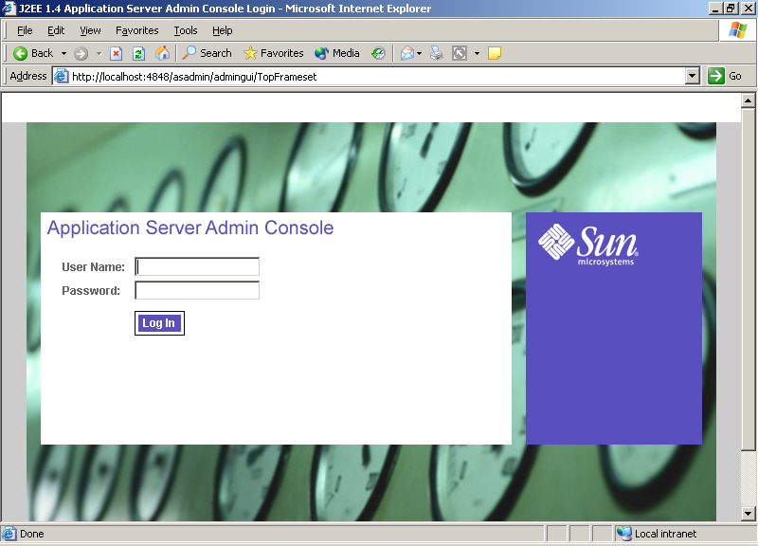
Restricting Resource Usage
  The following are the steps to create a user by using J2EE Application Server Admin Console:
    Run the J2EE Application Server Admin Console.

Slide 15
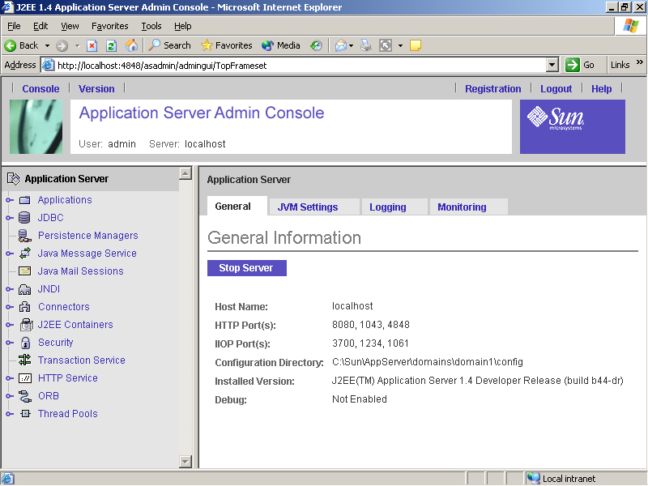
Restricting Resource Usage (Contd.)
  Specify the administrator’s username in the User Name textbox and password in the Password textbox to open the J2EE 1.4 Application Server Admin Console window.

Slide 16
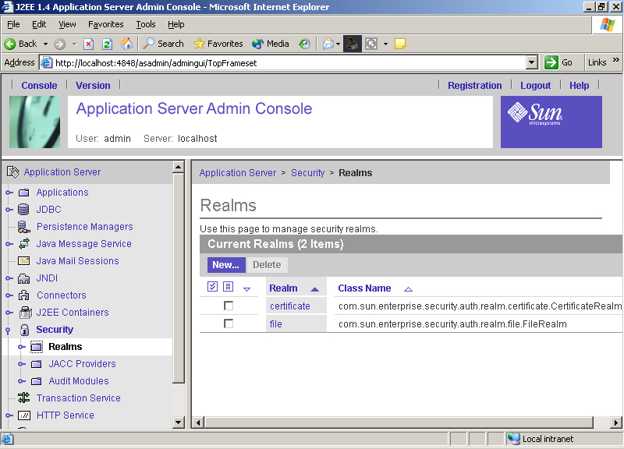
Restricting Resource Usage (Contd.)
  Click the Realms node under the Security node to display various security realms.

Slide 17
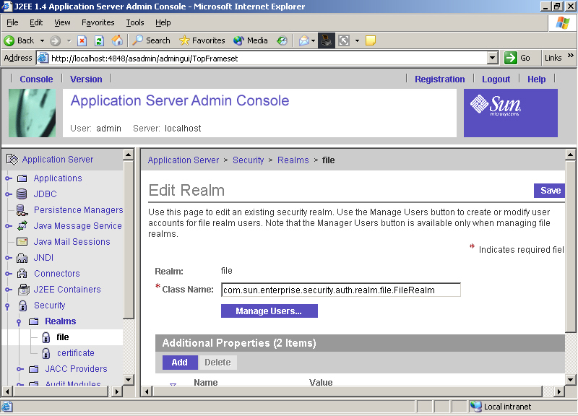
Restricting Resource Usage (Contd.)
  Click the file link to display the Edit Realm page of the file realm:

Slide 18
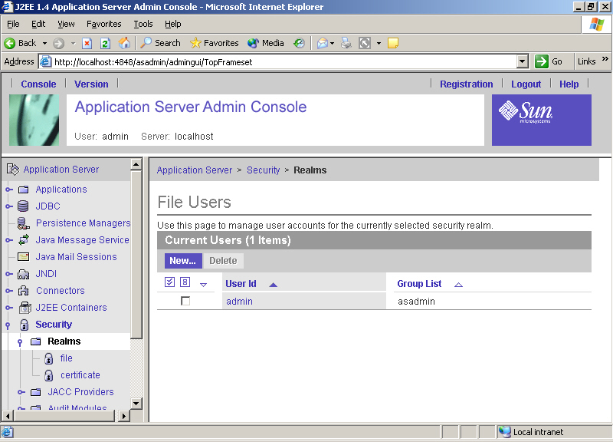
Restricting Resource Usage (Contd.)
  Click the Manage Users link in the preceding window to display the File Users page.

Slide 19
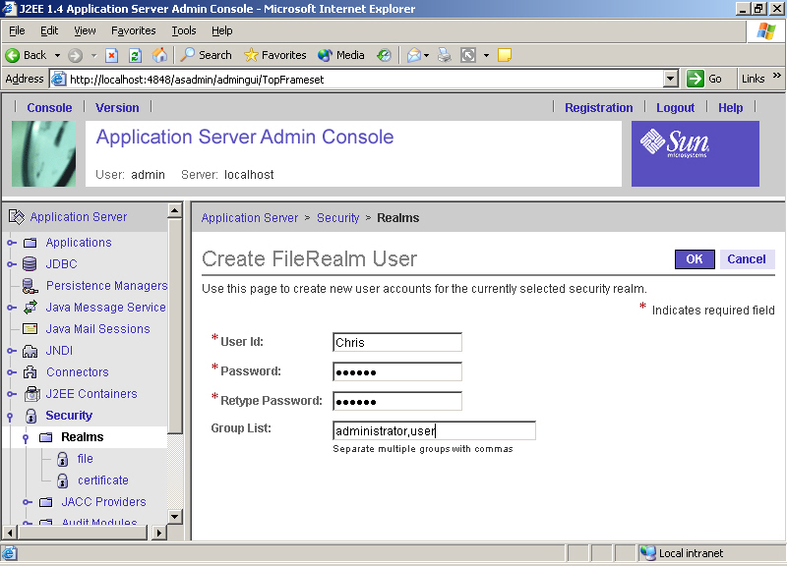
Restricting Resource Usage (Contd.)
  Click the New link in the File Users page to display the Create FileRealm User page.

Slide 20
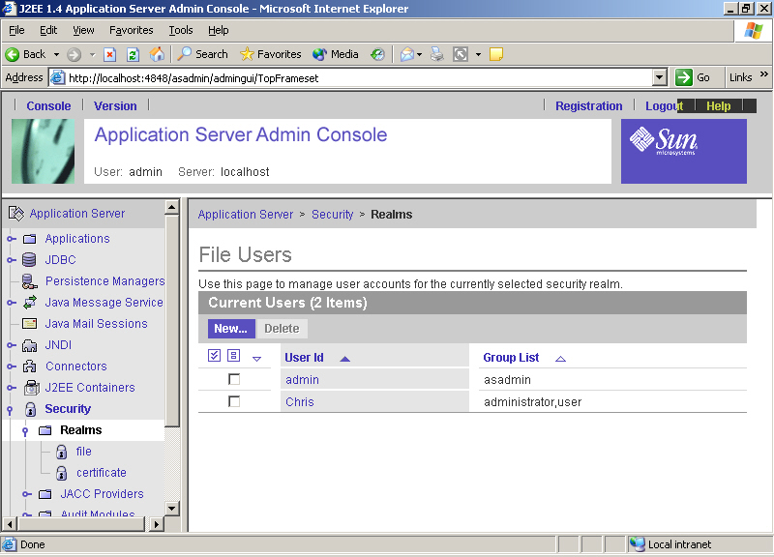
Restricting Resource Usage (Contd.)
  Specify the user information in the User Id, Password, Retype Password, and Group List text boxes in the Create FileRealm User page and click OK to add the user in the file realm.

Slide 21
Restricting Resource Usage (Contd.)
    Creating Roles
      Role refers to a common name for a group of users having similar permissions, such as, adding new resources, removing resources, or modifying the server settings in a Web application.
      The Web container denies access to users not linked with roles.
      The deployment descriptor specifies user roles using the <security-role>, <role-name> and <realm-name> deployment descriptor tags.
      The following code snippet shows the <security-role> deployment descriptor tag that specifies a role, User:
        <security-role>
        <role-name>User</role-name>
        <realm-name>Secure Authentication</realm-name>
        </security-role>

Slide 22
Restricting Resource Usage (Contd.)
  Specifying Authentication Techniques
    Authentication type is used to secure a Web application and is specified during the deployment process of the Web application.
    The deployment descriptor of a Web application specifies basic authentication type using the <login-config>, <auth-method>, and <realm-name> deployment descriptor tags.
    The following code snippet shows how to define the deployment descriptor tags for basic authentication:
    <login-config>
    <auth-method>BASIC</auth-method>
    <realm-name>Secure Basic Authentication</realm-name>
    </login-config>

Slide 23
Restricting Resource Usage (Contd.)
  Specifying Authentication Techniques (Contd.)
    The deployment descriptor of a Web application specifies form-based authentication type using the <login-config>, <auth-method>, <realm-name>, <form-login-config>, <form-login-page>, and <form-error-page> deployment descriptor tags.
    The following code snippet defines form-based authentication:
    <login-config>
    <auth-method>FORM</auth-method>
    <realm-name>Secure Form Authentication</realm-name>
    <form-login-config>
    <form-login-page>/login.html</form-login-page>
    <form-error-page>/error.html</form-error-page>
    </form-login-config>
    </login-config>

Slide 24
Restricting Resource Usage (Contd.)
  Specifying Authentication Techniques (Contd.)
    The deployment descriptor of a Web application specifies digest authentication type using the <login-config>, <auth-method> and <realm-name> deployment descriptor tags
    The following code snippet defines digest authentication:
    <login-config>
    <auth-method>DIGEST</auth-method>
    <realm-name>Secure Digest Authentication</realm-name>
    </login-config>

Slide 25
Restricting Resource Usage (Contd.)
  Specifying Authentication Techniques (Contd.)
    For each authentication technique, you also need to specify a security constraint during deployment.
    The security constraint specifies the Web resources collection that needs to be protected and the URL pattern that needs be checked before allowing access to the Web resource collection.
    The security constraint also specifies the role for which the constraint is enforced and the mechanism as to how data will be transported between a client and the server.

Slide 26
Restricting Resource Usage (Contd.)
  Specifying Authentication Techniques (Contd.)
  The following code shows the deployment descriptor tag <security-constraint> that specifies the security constraints of the authentication mechanism:
  <security-constraint>
  <display-name> SecurityConstraint</display-name>
  <web-resource-collection>
  <web-resource-name> WRCollection</web-resource-name>
  <url-pattern> /*</url-pattern>
  </web-resource-collection>
  <auth-constraint>
  <role-name> User</role-name>
  </auth-constraint>
  <user-data-constraint>
  <transport-guarantee> NONE</transport-guarantee>
  </user-data-constraint>
  </security-constraint>

Slide 27
Restricting Resource Usage (Contd.)
  Mapping Security Roles
    Role mapping specifies the permissions or rights associated with a user role.
    Roles are mapped during the deployment process of a Web application.
    The deployment descriptor specifies security role mapping using the <security-role-ref>, <role-name>, and <role-link> deployment descriptor tags.
    The following code snippet maps the user, Chris with the role, User:
    <security-role-ref>
    <role-name>User</role-name>
    <role-link>Chris</role-link>
    </security-role-ref>

Slide 28
Demonstration-Implementing Security
  Problem Statement
    Chris wants to read his e-mails on the server. He sends his login information to the server, which validates the information entered by Chris. If the login is successful, the server should display a login success message or else display an error message. Chris decides to authenticate his login information using form-based authentication.

Slide 29
Demonstration-Implementing Security (Contd.)
  Solution
    To solve the given problem, perform the following task:
      Create users using the J2EE Admin Console.
      Create a servlet for form-based authentication.
      Create the login form.
      Create the error page.
      Create the J2EE Web application.
      Create the Web component.
      Create a security role.

Slide 30
Demonstration-Implementing Security (Contd.)
        Specify the security elements for form-based authentication.
        Map the security role.
        Deploy the application.
        Test the application.

Slide 31
Demonstration-Implementing Security (Contd.)
  Implementing Programmatic Security
    Secures Web applications programmatically by declaring routines in the application to check security settings.
    Is implemented in cases where declarative security fails to enforce security in a Web application.
    Crosschecks a Web user’s role and user name with the security settings of the Web application before granting accessibility rights.
    Uses methods of the HttpServletRequest interface to customize security.

Slide 32
Demonstration-Implementing Security (Contd.)
  Implementing Programmatic Security (Contd.)
    Various methods of HttpServletRequest interface used for programmatic security are:
      String getRemoteUser(): Returns the login id of the user that requested the resource, otherwise returns null.
      Principal getUserPrincipal(): Returns the name of the currently authenticated user as an object of java.security.Principal.
      boolean isUserInRole(String role): Returns a boolean value indicating whether the user is mapped to the role passed as the method argument or not.

Slide 33
Summary
  In this lesson, you learned:
  You can secure Web Security issues in Web applications using authentication, authorization, and data integrity.
  Various techniques to authenticate clients are:
    Basic Authentication
    Digest Authentication
    Form-Based Authentication
    Client-Cert Authentication
  Restricting the access to the server resources by the clients can be achieved by defining user roles that can access the specified Web resources.
  You can create an authorized user in a J2EE realm using the J2EE Admin Console.

Slide 34
Summary (Contd.)
  You can creating a security role in J2EE Deploytool by defining deployment descriptor tags for user roles.
  Restricting access to Web resources by specifying authentication types in the deployment descriptor of the Web application.
  Mapping a security role to user in the J2EE Deploytool window.
  Programming the security of your Web application.

